Slide 1
Programming ivy - reference
July 6, 2016
Allart Ian Vogelesang ian.vogelesang@hds.com +1 408 396 6511

Slide 2
Two sections in this material
ivyscript programming language wrapper – for scripting test workflow
Similar to a subset of C/C++, with some minor differences.
Extensible - parser auto-generated from language grammar. (flex+bison)
Longer term - examine pros/cons of making part 2 a CLI that you could use in your favourite scripting language, if so, the current ivyscript programming language wrapper would be dropped.
Current idea for this is to transform ivy engine control statements into RESTful API calls in the context of "sessions".
ivy engine control statements
Operating the underlying ivy engine

Slide 3
The ivyscript programming language wrapper

Slide 4
ivyscript programming language
Statements in the programming language end with a semi-colon, like C / C++ / Java.
C style comments are supported
The part from /* to */ is ignored
C++ style comments are supported
From // to the end of the line is ignored.
# style comments are supported
From # to the end of the line is ignored.

Slide 5
Make .ivyscript programs executable
So-called "sha-bang" lines work.
A sha-bang line is when you start a script with a line that specifies a path to the program used to interpret the script.
For example, as the first line of an .ivyscript program: #!/path_to_ivy_executables/ivy (followed by remainder of ivyscript program)
Then you can invoke the .ivyscript file as a program itself.

Slide 6
Nested blocks
Anywhere you can put a statement, you can put a nested block, which starts with "{" and ends with "}".
Any variable or function declarations made inside a nested block are not "visible" to code outside the nested block.
Nested blocks are typically used in if statements, looping constructs, etc.

Slide 7
Types
There are 3 types: int, double, and string.
Examples of constants, also called literals:
int: 0 -5 12345 double: 5. .5 5.5 5E-2 5% 5.5% string: "house" ""
There is also a hex form of int literal (constant)
0x0 to 0x7FFFFFFF
The hex form of int literal only supports non-negative values
5% means the same thing as 0.05.

Slide 8
More on string literals
To include a double quote character in a string constant, escape it with a backslash:
"the word \"house\" is double-quoted"
Other escaped characters: \r, \n, \t
An escaped octal character value has 3 digits, e.g. \001
An escaped hex character value has one or two digits, e.g. \xf or \x0f

Slide 9
Identifiers
"identifiers" are eligible to serve as the name of a variable or function.
An identifier begins with an alphabetic character (a letter), and continues with letters, digits, and underscore _ characters.

Slide 10
Statement – variable declaration
<type> <list of identifiers with optional = <initializer expression>>;
Examples:
int i, j; int k = -1; double c; double d = 1.5; string s; string name = "bert";

Slide 11
Expressions
A constant (a literal of one of the types) is an expression
e.g. "constant"
A variable reference is an expression
e.g. x
Expressions may be combined together with operators, which operate the same as in C/C++:
+, -, *, /, %, >, <, >=, <=, ==, !=, =, |, &, ^, &&, ||
Expressions have a type, int, double, or string

Slide 12
Converting an expression to a different type
int( <expression> ) double( <expression> ) string( <expression> )
Some times called a "cast".
The expression is evaluated and the result is converted to the target type.
Can result in a run time error
E.g. evaluating int("cow") would cause a run-time error.

Slide 13
Operators - arithmetic
+ plus – for numbers, adds, for strings, concatenates - minus * multiply / divide % remainder from integer division

Slide 14
Logical operators - comparison
> greater than < less than >= greater than or equal to <= less than or equal to == equal to != not equal to
There is no true/false type. Logical operators evaluate to an integer value just like the old C language before there was a bool type.
An int or a double value used as a logical expression means "false" if the numeric value is zero, and means "true" for any non-zero value.
Use of int logical values is transparent – it works the way you expect it to.

Slide 15
Bitwise or, bitwise and, bitwise exclusive or
The bitwise operators operate on the individual bits in an int value, exactly like in C/C++.
| bitwise or & bitwise and ^ bitwise exclusive or

Slide 16
Logical or, and, not
These operate on logical expressions, which evaluate to an int interpreted to mean "false" if the int value is zero, "true" otherwise.
Like in C/C++ the second expression after the operator is not evaluated if the result is known from evaluating the first expression before the operator.
|| logical or
Evaluates the first expression, and if true, returns true. Otherwise, it evaluates the second expression and returns its true/false value.
&& logical and
Evaluates the first expression, and if false, returns false. Otherwise it evaluates the second expression and returns its true/false value.
! not
Evaluates a logical expression and returns the opposite.

Slide 17
Assignment expression
<identifier> = <expression>
The identifier is looked up in the symbol table at compile time, and if it’s valid, at execution the expression is evaluated and the variable is set to that value.
If the expression is not of the same type as the variable, the value may be coerced / converted, or in some cases a compile time error occurs.

Slide 18
Function call expression
<identifier> ( <comma separated list of zero or more expressions> )
E.g. sin(.5)
Identifier and parameter list signature are looked up at compile time to and if valid, a function call is built.
At run time, the expressions are evaluated and the resulting parameter values are passed to the function, the function is executed, and the result is returned.

Slide 19
Operator precedence
Same as C/C++
if ( 3*4+5*6 == fred || ! Person == Nancy = 4)
Means
if ((((3*4)+(5*6))==fred)||(!(Person==(Nancy=4))))
If you are not sure, group with parentheses ().

Slide 20
User-defined functions
E.g.
int add_three( int i ) { return i+3; };
Functions have a type, which is the type of the object they return to the caller.
Functions can be "declared" without being defined yet: int add_three(int i);
Semicolon needed for function definitions, unlike C/C++

Slide 21
Function overloading
It’s OK to have different functions with the same name as long as the sequence of types of the parameters is different so the compiler can tell them apart.
int addtwo(int i) { return i+2;} string addtwo(string s) { return s + "two";}

Slide 22
Ivy-specific builtin functions
string outputFolderRoot(); from [OutputFolderRoot] statement – default "."
string testName(); root part of ivyscript file without .ivyscript suffix
string masterlogfile(); you can log(masterlogfile(), "message\n");
string testFolder(); root folder for output from this run
string stepNNNN(); from most recent [Go!], e.g. step0002
string stepName(); from most recent [Go]
string stepFolder(); subfolder for most recent [go] within testFolder()
string last_result(); for most recent [Go], returns "success" or "failure"
string show_rollup_structure(); shows type / instance / workload thread hierarchy.

Slide 23
Math builtin functions – same as C/C++
double sin(double), double cos(double), double tan(double)
double sinh(double), double cosh(double), double tanh(double)
double asin(double), double acos(double), double atan(double), double atan2(double,double)
double log(double), log10(double), double exp(double), double pow(double,double)
double sqrt(double)
int abs(int) - absolute value
double pi(), double e()

Slide 24
String builtin functions
string substring(string s, int begin_index_from_zero, int number_of_chars);
string left(string s, int n); like in BASIC, gives you leftmost / rightmost characters string right(string s, int n);
string trim(string s); removes leading / trailing whitespace
string to_lower(string s); string to_upper(string s);
int stringCaseInsensitiveEquality(string s1, string s2);
string int_to_ldev(int n); int_to_ldev(0xFF) returns "00:FF"
string to_string_with_decimal_places(double x, int n); to_string_decimal_places(3.1415,2) returns "3.14"

Slide 25
regex builtin functions
ivy uses the default flavour of C++ std::regex, which I think uses the ECMAscript dialect
int regex_match(std::string s, string regex); E.g. if ( regex_match("horse","(horse)|(cow)") ) then print("animal\n");
int regex_sub_match_count(string s, string regex);
string regex_sub_match(string s, string regex, int n); n must be less than regex_sub_match_count(s, regex)
int matches_digits(string s); int matches_float_number(string s); int matches_float_number_optional_trailing_percent(string s); some ivy parameters can be set to these int matches_identifier(string s); alphabetic, continued with alphanumeric and underscores _ int matches_IPv4_dotted_quad(string s);

Slide 26
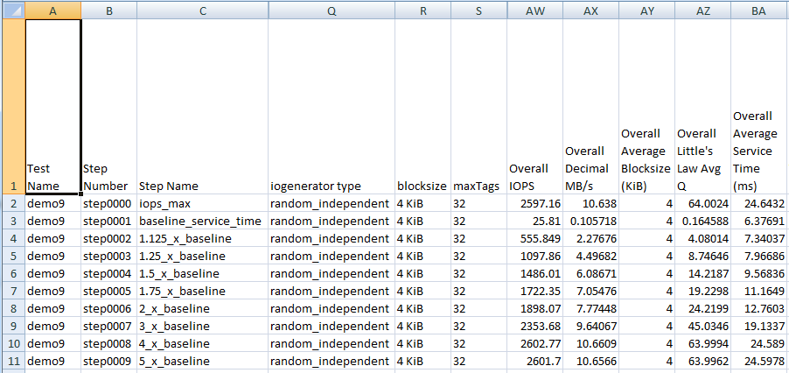
Accessing csv files – row and column
Test step csv files (not shown) have one line per subinterval
(both host & subsystem data) Summary csv files like this one have one line per test step.
Header row is row -1
Row 0 is test step 0 or subinterval 0
Use column number from 0, or say "Overall IOPS"

Slide 27
Csv file builtin functions 1/3
set_csvfile(string filename);
Loads csv file into a kind of spreadsheet object, if it's not already loaded into memory.
You can load multiple csv files and switch back and forth.
All subsequent csvfile calls refer to the currently set csvfile.
drop_csvfile(string filename);
If you are done with it and you would like to release the space.
int csvfile_rows();
Number of rows following the header row.
Returns -1 if invalid file or file empty. Returns 0 if there was only a header row.
int csvfile_columns_in_row(int row); int csvfile_header_columns(); same as csvfile_columns_in_row(-1)

Slide 28
Csv file builtin functions 2/3 – individual cells
string csvfile_cell_value(int row, int column); string csvfile_cell_value(int row, string column_header_text);
You can refer to a column using an int, the column index from zero.
You can refer to a column using a string, the column header text.
string csvfile_raw_cell_value(int row, int column); string csvfile_raw_cell_value(int row, string column_header_text);
ivy "wraps" text fields as a formula with a string constant, e.g. ="horse"
This stops Excel from interpreting 1-1 as January 1st, and 00:00 from interpreting as a time.
The csv file functions normally "unwrap" csv column values, removing this kind of wrapper or removing simple double quotes surrounding a value, to treat ="horse", "horse" and horse the same
Retrieving the raw value give you exactly what was between the commas in the csv file.

Slide 29
Csv file builtin functions 3/3 – headers & slices
string csvfile_column_header(int col);
Give you the text of the column header
string csvfile_column(int col); string csvfile_column(string column_header);
Gives you a "column slice" of the spreadsheet showing "raw" values.
E.g. "IOPS,55,66,55,44"
Demo number 8 shows iterating through the column slices to write out the transpose of a csv file.
string csvfile_row(int row);
Gives you a "row slice" of the spreadsheet showing the "raw" values.
E.g. ="random_independent",="4 KiB",32,2601.7

Slide 30
utility functions
string print(string), double print(double), int print(int)
Prints the specified value to stdout and then returns that value.
int fileappend(string filename, string s)
One way to write output. Does not append a newline to s.
int log(string filename, string s)
Writes a timestamp prefix before the string, and adds terminating newline if the last line in s doesn't already have one.
E.g. log(masterlogfile(),"message");
trace_evaluate(int)
Turns execution tracing on/off. Zero means off, otherwise on.

Slide 31
Builtin functions – shell_command
string shell_command(string)
Executes the shell command and returns its output.
Runs as root. You have been warned.
Ivy runs as root in our lab because ivy uses ssh to fire up ivyslave and ivy_cmddev on test hosts, and "root" has been set up to not require a password to ssh. Ivy may also need to run as root to do I/O to raw LUNs – not sure.
The only ivy component that definitely requires to run as root is the SCSI Inquiry tool, which has the executable that issues "SCSI Inquiry" marked setuid as root, and thus works for any user.
Use shell_command() to do almost anything
grep in an ivy output folder to find a csv file name
Get a time or date stamp

Slide 32
Builtin functions – exit()
As in
if ( last_result() != "success" ) { print "timed out without making a valid measurement.\n"; exit(); }

Slide 33
Statements: expression statement
<expression> ;
Executes the expression and discards the result.

Slide 34
Statements – if / then / else
if ( <logical expression> ) <statement>
if ( <logical expression> ) <statement> else <statement>
<statement> can be a single statement, or it can be a nested block starting with { and ending with }.
int x = 1; if ( x >= 0 ) print( "x is greater than or equal to zero.\n"); else print( "x is less than zero.\n"); if ( x >= 0 ) { print( "x is greater than or equal to zero.\n"); x = x + 1; } else { print( "x is less than zero.\n"); x = x – 1; }

Slide 35
Statements – traditional C style for loop
for ( <initializer expression> ; <logical expression>; <epilogue expression> ) <loop body statement>
The initializer expression is run.
Then the logical expression is evaluated, if false, execution of the statement is complete.
Otherwise, the loop body statement is run, then the epilogue expression is run, then we loop back to where we will evaluate the logical expression.

Slide 36
Example of traditional for loop
int i; for ( i=0; i<10; i=i+1 ) { print( "i = " + string(i) + "\n"); }
Note that it’s not for (int i=0; i<10; i++)
The initializer is an expression, not a statement, so can’t declare i to be an int.
There is no C++ increment operator ++.

Slide 37
Statement – list-style for loop
For <identifier> = { <list of expressions> } statement
E.g. int i; for i = { 0, 1, 2 } print("i = " + string(i) + "\n"); string s; for s = { "cat", "dog", "mouse" } { print ( "A " + s + " has four legs.\n"); }

Slide 38
Statement – while loop
while ( <logical expression> ) <loop body statement>
The logical expression is evaluated, and if false, execution of the statement is complete.
Otherwise, the loop body statement is executed and then we loop back to evaluating the logical expression again.

Slide 39
Statement – do - while loop
do <loop body statement> while ( <logical expression> ) ;
The loop body statement is executed, and then the logical expression is evaluated, and if the result was "false", execution of the statement is complete.
Otherwise, and then we loop back to running the loop body statement again.

Slide 40
Operating the ivy engine

Slide 41
The "test name"
When ivy is invoked on the command line like
ivy some/path/henri.ivyscript
The henri in some/path/henri.ivyscript, the part of the ivyscript filename discarding the path and the .ivyscript suffix, is called the "test name".
It’s used as the subfolder name off of the [OutputFolderRoot] folder.

Slide 42
"test name" – used in output filename prefixes
The test name is also used as part of the prefix of ivy output filenames.
So that you can combine together in one folder any files from multiple ivy runs and there wouldn’t be name collisions as long as the test names were different.
So that if you threw all the output files in one folder they would sort on nicely on filename, grouping like they were grouped in the original folders.
So that if all you get is the file, you still knew which folder it came from.

Slide 43
Statements – [OutputFolderRoot]
[OutputFolderRoot] <string literal>;
Specifies a root folder which must already exist.
The default is "." (the current folder).
Specifies the root folder in which ivy will make a subfolder to record the output from running an .ivyscript program.
A string literal (string constant) is required, because the output root folder name is captured at compile time.
This way, the output folder structure and log files can be all in place before the ivyscript program starts running.
At most one [OutputFolderRoot] statement, anywhere in your program.

Slide 44
Statement – [Hosts]
[Hosts] <list of hosts> [Select] <select spec> ;
Forms of specifying test hosts:
<string expression for ivyscript_hostname>
E.g. "sun159" [must look like an identifier]
<dotted quad - not in quotes>
E.g. 192.168.1.1
<starting hostname> to <ending hostname or number>
Shorthand for a series of hostnames with numeric suffixes.
E.g. "cb16" to "cb31" or just "cb16" to "31" or even "cb16" to 31

Slide 45
[Hosts] statement starts up ivy on test hosts
On each specified host, the "ivyslave" executable is started using an ssh command.
Master host must be set up to ssh to test hosts without a password (that is, using certificate-based authentication.)
Have only tried running ivy as root. Don't know if a regular user is permitted to do raw LUN I/O.
Each test host discovers all its storage LUNs, using a SCSI Inquiry-based LUN lister utility program.
ivy uses Ian’s "showluns.sh" that decodes Hitachi proprietary attributes like subsystem type, serial number, LDEV, Port, PG, CLPR
The combined list from all the test hosts is "all discovered LUNs"

Slide 46
Vendor-independent LUN attribute discovery
command line: ivy test2
External SCSI Inquiry tool outputs csv file decoding LUN attribute names & values
test2.ivyscript
testhost3
[hosts] "testhost1" to "testhost3"
testhost2
ivyslave executable
testhost1
master host
ivyslave executable
ivy executable
ivyslave executable
showluns.sh executable
csv column headings become selectable in ivy
Host,LUN,HDS Product,LDEV,PG testhost1,/dev/sdxy,VSP,00:00,1-1
testhost2,/dev/sdxy,VSP,00:01,1-2
testhost3,/dev/sdxy,VSP,00:02,1-3
Host,LUN,HDS Product,LDEV,PG testhost1,/dev/sdxy,VSP,00:00,1-1

Slide 47
Sample attribute values from LUN lister tool
hostname = cb23 LUN_Name = /dev/sdbu Hitachi_Product = HM700 HDS_Product = "HUS VM" Serial_Number = 210030 Port = 1A LDEV = 00:00 Nickname = "" LDEV_type = Internal RAID_level = RAID-1 Parity_Group = 01-01 Pool_ID = "" CLPR = CLPR0 Max_LBA = 2097151 Size_MB = 1073.741824 Size_MiB = 1024.000000 Size_GB = 1.073742 Size_GiB = 1.000000 Size_TB = 0.001074 Size_TiB = 0.000977 Vendor = HITACHI Product = OPEN-V

Slide 48
LUN attribute matching
The LUN lister tool output csv file header line defines the LUN attribute names:
e.g. "HDS Product,Serial Number, LDEV,..."
Internally within the C++ LUN object, ivy takes that column header, trims off any surrounding quote marks and white space, then converts all non-alphabetics/non-digits to underscores _, translates to lower case, and uses that internally within the object as the key.
Then later on, if you ask if the LUN contains "HDS Product" or you ask for "hds_product", the LUN object's lookup routine does the same thing to the name you ask for before looking it up – either has the same effect.
Similarly, when you ask if a value matches a LUN, the same normalization of the values is done before deciding if there is a match.

Slide 49
"all discovered LUNs" -> "available test LUNs"
On the [Hosts] statement, the [Select] clause filters from all discovered LUNs on all the specified test hosts to create the pool of "available test LUNs" upon which you can "[CreateWorkload]".
Only on the [hosts] statement, the [Select] clause must specify a non-null value for at least one of "serial_number" (which we always have for Hitachi) or "vendor" (if we are testing another vendor’s equipment).
This is designed to prevent accidental annihilation of your boot drive.

Slide 50
[Select] syntax
<expression for attribute name> is <expr. for att. value>
"LDEV_type" is "DP-Vol"
<expression for attribute name> is { <list of attribute value expressions> }
"port" is { "1A", "3A", "5A", "7A" }
The Select clause matches against a LUN if that LUN has the specified attribute and the value of that attribute matches.
Select clauses are parsed by outer programming language, so there are no quotes around the entire [Select] expression.

Slide 51
[Select] LDEV, PG
There are a couple of cases of "custom" attribute value matching for Hitachi subsystems. (Other vendors are encouraged to write their own.)
There is a custom matcher for "LDEV" which understands things like "00:1A-00:3F, 01:FF"
There is a custom matcher for "PG" which understands
"1-*" matches PG names starting with 1-
"1-2:4" matches 1-2, 1-3, 1-4
"1-2:" matches 1-2, 1-3, …
"1-:2" matches 1-1, 1-2

Slide 52
[hosts] – use of command devices is automatic
After we have "available test LUNs", (which excludes command devices)
The [hosts] statement looks through the command devices that were part of "all discovered LUNs", and for each unique subsystem serial number in available test LUNs, for the first command device found that goes to that subsystem, if the Hitachi proprietary command device connector "ivy_cmddev" (not part of the ivy open source project) is available, we fire it up remotely on the test host that has the command device, and retrieve the RMLIB API data on the configuration of the subsystem.
For each available test LUN, if we have RMLIB API configuration data for the LDEV behind that LUN, the RMLIB API LDEV configuration attribute value pairs are merged into the LUN’s attributes.
That means that if you have a command device, you can select on drive_type to create a workload.
Later, when we run a test step, RMLIB API performance data is collected on the same time boundaries as the test intervals and that data goes in a csv file set for that test step.

Slide 53
Statements - [SetIogeneratorTemplate]
[SetIogeneratorTemplate] "random_steady" [parameters] "IOPS = 20, blocksize = 4KiB" + ", maxtags = 10, fractionRead = 50%";
Sets the defaults for the specified I/O generator name.
If you are going to use multiple [CreateWorkload]s with minor variations, you could use [SetIogeneratorTemplate] to set all the things that are in common, and then when you create each workload you only specify what’s unique for that workload.
Handy if you are going to create a series of sequential workloads each starting at a different point in the LUN or having coverage of a different portion of the LUN. Then when reading the program, it's more clear what's going on if the [CreateWorkload] only sets what's different each time.
The ivyscript language parser expects a single character string expression for [Parameters], as the string is passed as a whole to the corresponding underlying ivy engine function, which parses it there.

Slide 54
[iogenerator] some common [parameters]
VolumeCoverageFractionStart default 0.0 same as 0% VolumeCoverageFractionEnd default 1.0 same as 100%
Establishes the "coverage zone" within the LUN. You can layer different workloads in different parts of the same LUN.
blocksize default "4 KiB" same as "4096" – also supports "MiB" units.
maxTags default 1.
The maximum number of I/Os that this workload on this LUN is allowed to try to issue at one time.
OS call to start I/Os may block if underlying HBA/device driver is out of tags. Workloads share LUNs and share the underlying HBA/device driver.
IOPS default 5
IOPS = "max" - keep starting I/Os trying to keep queue depth at "maxTags".
fractionRead default 1.0 same as 100%.

Slide 55
[iogenerator] random – two types
random_steady
I/Os are issued to random locations on a steady drumbeat in time.
random_independent
I/Os occur at random times as well as to random locations
Random independent distributions are easier to model mathematically.
The lower the IOPS rate or the shorter the observation period, the more erratic random_independent IOPS will appear.
In general, random_independent I/O patterns will have a slightly higher service time compared to random_steady workloads, because scheduled I/O start times are independent and in general can collide (bursty), whereas random_steady workloads space out I/O scheduled start times evenly.

Slide 56
[iogenerator] "sequential"
In ivy, a sequential workload must be all reads (fractionRead=1.0 or fractionRead=100%) or all writes (fractionRead=0%).
But, you can use a for loop to create a series of sequential threads starting at different points along the LUN, where each of the threads is either a read thread or a write thread
SeqStartFractionOfCoverage = 0.23
Range is from 0.0 to less than 1.0 - this is relative to the volume coverage zone defined from VolumeCoverageFractionStart to VolumeCoverageFractionEnd.
More commonly use the volume coverage parameters to have sequential threads wrap around in their own areas.

Slide 57
Sequential example – volume coverage
Use a loop to create 10 sequential threads where each of the 10 threads operates within its own 1/10th of the LUN – its own “zone”, so that when it gets to the end of its own zone, it should wrap around to the beginning of that zone.
[hosts] "sun159" [select] "serial_number" is 83011441; int zones = 10; int zone; double start, end; for (zone = 0; zone < zones; zone = zone + 1) { start = double(zone)/double(zones); end = double(zone+1)/double(zones); [CreateWorkload] "zone" + string(zone) [iogenerator] "sequential" [parameters] "VolumeCoverageFractionStart=" + string(start) + ",VolumeCoverageFractionEnd=" + string(end) + ",IOPS=max, blocksize=64KiB, fractionRead=100%, maxTags=1"; }
[CreateRollup] "workload"; // this is to give us data by zone across all LUNs [Go] "stepname=separate_zones, measure_seconds = 60";

Slide 58
SeqStartFractionOfCoverage
Use a loop to create 10 sequential threads where each of the threads covers the entire LUN, wrapping around from the end of the entire LUN to the beginning of the LUN, but where each thread starts at a different equally spaced point.
[hosts] "sun159" [select] "serial_number" is 83011441; int zones = 10; int zone; double start; for (zone = 0; zone < zones; zone = zone + 1) { start = double(zone)/double(zones); [CreateWorkload] "zone" + string(zone) [iogenerator] "sequential" [parameters] "SeqStartFractionOfCoverage=" + string(start) + ",IOPS=max, blocksize=64KiB, fractionRead=100%, maxTags=1"; }
[CreateRollup] "workload"; // this is to give us data by zone across all LUNs [go] "stepname=whole_LUN_staggered_start, measure_seconds = 60";

Slide 59
Sequential example – read threads & write threads
Use a loop to create a group of sequential workload threads each operating within its own "zone", and where some threads do writes and some do reads.
[hosts] "sun159" [select] "serial_number" is 83011441; int zones = 12; int zone; double start, end; double seq_percent_read = 75%; for (zone = 0; zone < zones; zone = zone + 1) { start = double(zone)/double(zones); end = double(zone+1)/double(zones); double rw; string p; if ( ( double(zone) / double(zones) ) < seq_percent_read ) { rw = 100%; p = "read_"; } else { rw = 0%; p = "write_"; } [CreateWorkload] p + "zone" + string(zone) [iogenerator] "sequential" [parameters] "VolumeCoverageFractionStart=" + string(start) + ",VolumeCoverageFractionEnd=" + string(end) + ",IOPS=max, blocksize=64KiB, maxTags=1" + ", fractionRead=" + string(rw); } [Go] "stepname=read_and_write_zones, measure_seconds = 60";

Slide 60
Sequential workloads and maxTags
The default maxTags value is 1.
ivy iogenerators (I/O sequencers) generate a sequence of I/Os in scheduled start time order.
For IOPS=max, the scheduled start time for each I/O is zero.
For all iogenerators, if you specify, for example, maxTags=4, this means "keep issuing I/Os when it's the scheduled time, except wait to start the next I/O if there are already 4 I/Os running".
For a sequential workload, IOPS=max, maxTags=4 means "issue I/Os for 4 consecutive blocks at once, and then when one of these completes, keep issuing more to try to keep 4 running at all times."

Slide 61
Statements - [CreateWorkload]
[CreateWorkload] "r_steady" [select] "LDEV" is "00:04" [iogenerator] "random_steady" [parameters] "fractionRead = 75%"
Apply a [select] filter matching against "available test LUN" attribute values.
On each selected LUN, create an identical workload thread with the specified workload name, running the specified [iogenerator] plug-in, and supplying the [iogenerator] with a [parameters] text string that the iogenerator will parse and apply.
Each type of iogenerator has its own set of valid parameter names.

Slide 62
[CreateWorkload]
Attributes for selection are those of the underlying LUN plus several special built-int attributes
workload, set to the specified workload name, and
host which is an alias for ivyscript_hostname, the name used on the [hosts] statement which might be an alias or a dotted quad.
The newly created workload threads will be in "waiting for command" state.

Slide 63
.ivyscript dedupe syntax
[CreateWorkload] "owl" [select] "port" is "1A" [iogenerator] "random_steady" [parameters] "IOPS=max,fraction_read=\"50%\", blocksize = \"4KiB\" dedupe = 1.5 ";
The dedupe parameter (default dedupe = 1.0) controls the average number of copies of a generated pattern that is written across the set of workload threads each mapped to a LUN on a test host with the same workload name (e.g. "owl")
dedupe must set to a value greater than or equal to 1.0
It is an error if some workload threads are set to a different dedupe value than other workload threads with the same name.
The dedupe parameter is ignored for fraction_read = 100%.

Slide 64
.ivyscript compressibility syntax
[CreateWorkload] "owl" [select] "port" is "1A" [iogenerator] "random_steady" [parameters] "IOPS=max,fraction_read=\"50%\", blocksize = \"4KiB\" pattern = random ";
The pattern parameter selects a pattern generator to fill the contents of a block before it is written to the LUN.
The default is pattern = random.

Slide 65
.ivyscript pattern parameter
pattern = random
Random binary noise. Not compressible. This is the ivy default
pattern = trailing_zeros, compressibility = 50%
Each block has an incompressible section and a section with repeated zeros.
compressibility specifies the % of the block that is repeating zeros.
pattern = ascii
Random ascii characters. Fixed degree of compressibility
pattern = gobbledegook
Pseudo-English text generated by randomly selecting words from a dictionary.
Fixed degree of compressibility.
Using the first 32 Ki Words appearing in the 1913 public domain edition of Webster's dictionary.

Slide 66
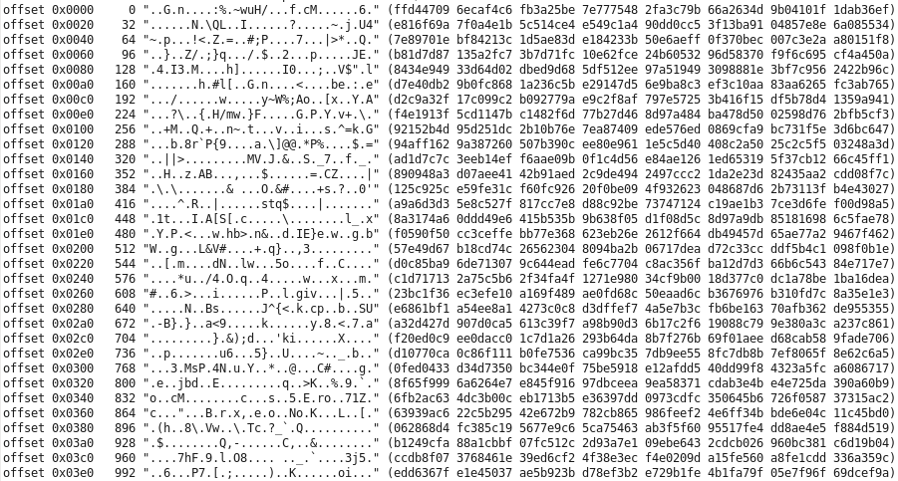
pattern=random
Random binary data
(incompressible)

Slide 67
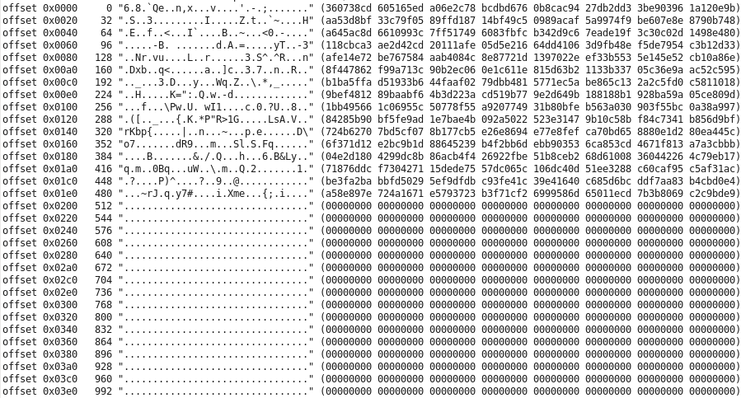
pattern=trailing_zeros,compressibility=50%
Leading part of block is random binary data
(incompressible)
compressibility = 50% means 50% trailing binary zeros

Slide 68
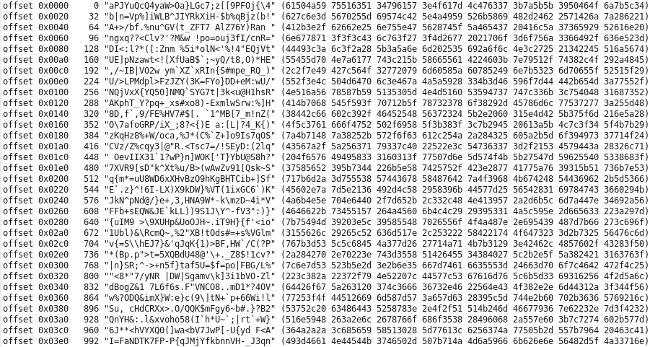
pattern=ascii
Randomly selected printable ASCII characters
(fixed degree of compressibility)

Slide 69
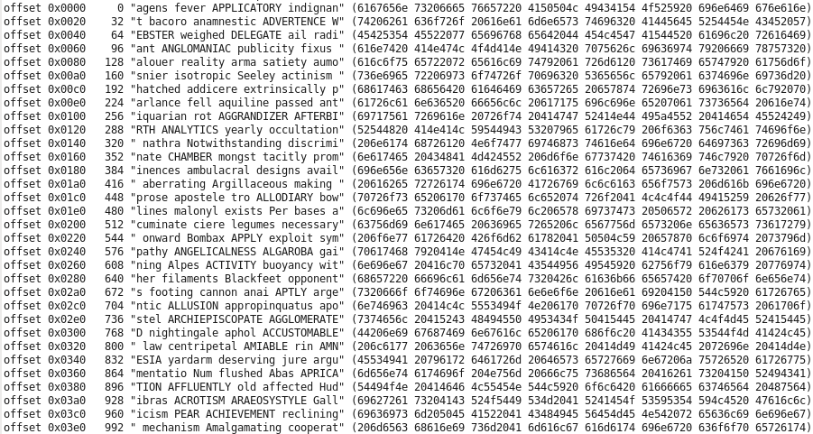
pattern=gobbledegook
Randomly selected words from Webster's 1913 dictionary.
(fixed degree of compressibility)

Slide 70
Statements - [DeleteWorkload]
[DeleteWorkload] "r_steady" [select] "LDEV" is "00:04";
[DeleteWorkload] "r_steady" ;
Deletes all instances of the r_steady workload on all test hosts / all LUNS.
[DeleteWorkload] ;
Deletes all workloads.

Slide 71
Statements – [CreateRollup]
[CreateRollup] "Serial_Number+Port"
[CreateRollup] "host" [nocsv] [quantity] 8 [MaxDroop] "25%";
A rollup is a partition of all workload threads.
Every workload thread belongs to exactly one instance of each rollup.
There is always an "all" workload which only has one instance "all".
[nocsv],[quantity],[MaxDroop]are optional, but if they appear they must be in that order
To get individual data for each workload thread, say "workloadID " which is comprised of "host+LUN_name+workload".

Slide 72
You make rollups for four reasons
To get an output csv file with a csv folder by rollup type (e.g. Port+CLPR) and csv files by rollup instance (e.g. Port+CLPR = 1A+CLPR0)
This is how you get custom "sliced & diced" data.
To perform dynamic feedback control (dfc=PID) at the granularity of the rollup instance.
To identify a valid measurement period at the granularity of the rollup instance using measure=on.
To validate the test configuration as operating correctly
E.g. test that the number of ports reporting was what you expected
E.g. validate that no one port had an IOPS too far below the highest IOPS seen on any port.

Slide 73
Rollups are key to how the ivy engine works
[CreateRollup] "Serial_Number+Port" (no spaces are permitted around the + sign)
Both Serial_Number and Port must be valid LUN-lister column header attributes, or built-in layers on top of those attributes
Then for all existing WorkloadIDs, we build a data structure that looks like this
"Serial_Number+Port"
"410123+1A"
"sun159+/dev/sdd+workload_name", "cb28+/dev/sdd+workload_name",
"410321+1A"
"sun159+/dev/sdf+workload_name", "cb28+/dev/sdf+workload_name"
"host"
"sun159"
"sun159+/dev/sdd+workload_name", "sun159+/dev/sdf+workload_name"
"cb28"
"cb28+/dev/sdd+workload_name", "cb28+/dev/sdf+workload_name"
Every WorkloadID appears exactly once in each rollup type
The rollup type
The rollup instance. It’s the rollup instance that has the rolled up data.
List of WorkloadIDs that "landed" on this rollup instance

Slide 74
[CreateRollup] combines LUN attribute names
If you would like to see a rollup instance for each unique LDEV across two or more subsystems, make "serial_number+LDEV".
[nocsv] – prevents csv files from being created.
The [quantity] <int expression> clause can enforce that the right number of distinct rollup instances are reporting in this rollup.
If not, even if the DFC reports "success" and designates a subinterval subsequence representing a successful measurement, no measurement rollup csv data will be produced – instead error msg.
Make a rollup by "port" or "host+scsi_bus_number__hba_" and use the [quantity] rollup to validate you have the number of paths you think you have.
[MaxDroop] <double expression>
"25%" means invalidate test if any one rollup instance has an average IOPS more then 25% below the highest average IOPS over all rollup instances.

Slide 75
[DeleteRollup]
[DeleteRollup] "serial_number+Port";
[DeleteRollup] ;
Deletes all rollups except the "all" rollup.

Slide 76
[EditRollup]
[EditRollup] "serial_number+Port = { 410123+1A, 410123+2A }" [parameters] "fractionRead = 100%";
The [EditRollup] statement operates in between test steps while the workload threads are in "waiting for command" state.
It gives you access to the same mechanism used by a Dynamic Feedback Controller to send out real time parameter updates to running workload threads.
You specify a set of rollup instances to send to, such as "all=all", or "Port={1A,3A,5A,7A}" and you specify the text [parameters] string to send to the remote iogenerator to parse and apply.

Slide 77
[EditRollup]
[EditRollup] is typically used at the top of a do-loop, to change whatever parameters vary by loop pass.
Use [EditRollup] "all=all" to send to all workload threads.
There is a special parameter name that is only recognized by [EditRollup] - total_IOPS - where the numeric value you specify is divided by the number of workload threads comprising a workload instance, before being sent out as IOPS=.
[EditRollup] "all=all" [parameters] "total_IOPS = 1000000";

Slide 78
Statement – [Go]
[Go] "stepname = random4K, subinterval_seconds = 5, …"
The [Go] statement starts the workload threads running a "test step", which is a sequence of "subintervals" each of a duration specified in the subinterval_seconds parameter, defaulting to 5 seconds.
If you have a case for using ivy to measure a restricted set of things much more frequently, we can talk about putting in support.
Most of the time 5 seconds is plenty short and if you are going to be doing any tests that will run for hours you may want to consider a longer subinterval just to mercifully cut down on the size of the csv files by subinterval.
Sometimes when you say you want an answer to +/- 1% and the behaviour is a bit noisy, it can take time to see enough to say you are sufficiently confident statistically. (Did you say you wanted "valid" data?)

Slide 79
catnap_time_seconds & post_time_limit_seconds
[Go] "…, catnap_time_seconds = 1.2, post_time_limit_seconds = 2.5, …"
catnap_time_seconds is the amount of time that ivyslave waits after the scheduled subinterval end time before it starts to try to get the lock and check if each WorkloadThread has posted the subinterval data as "ready to send".
From then, if any of the WorkloadThreads haven't yet posted the subinterval data as "ready to send", ivyslave waits in increments of 0.25 x catnap_time_seconds.
Ivyslave posts an <Error> if we would have waited for more than post_time_limit_seconds after the end of the subinterval.
If any WorkloadThreads posted after the catnap time, but before the limit time, a <Warning> log message is posted in the ivyslave log file. If any WorkloadThreads posted at or after 2.0 x the catnap time, the <Warning> message is sent to ivymaster to display on the console log and record in the ivymaster log. This way you are notified if the catnap time may be too short.

Slide 80
Test step = warmup, measure, cooldown
warmup
measurement
cooldown
Subinterval 0
Subinterval 1
Subinterval 2
Subinterval 3
Subinterval 4
First measurement subinterval
Last measurement subinterval
There must be at least one warmup, one measurement, and one cooldown subinterval.
Parameter defaults
warmup_seconds = 5 - this number is divided by subinterval_seconds, and rounded up to get the (minimum) number of warmup subintervals.
measure_seconds = 60 - also rounded up to the minimum number of measurement subintervals.
cooldown_by_wp = on - If a command device is available for the subsystem under test, the cooldown period is extended until write pending is empty.

Slide 81
For each test step you get:
A subfolder of the overall test output folder that contains the csv files with one line for each subinterval in that test step.
Nested subfolders for each workload data rollup
Containing a csv file for each rollup instance, with one line per subinterval.
A nested subfolder with raw RAID_subsystem RMLIB API data.
Collected time-synchronized "just before" the end of each subinterval.
A single line in the overall test results "summary.csv" files.
In ivy terminology, this is called a "measurement" line, which represents the rollup from the first to last measurement subintervals.
Unless "measure=on" with specified accuracy timed out – then you get an error message line

Slide 82
cooldown_by_wp
Default: cooldown_by_wp = on
Set cooldown_by_wp = off
When it is valid to carry forward dirty data in cache (Write Pending) from one test step to the next.
This can speed up the next test step tremendously if
the next step doesn’t stabilize until WP is full,
AND if both steps place the SAME things into WP.

Slide 83
The default [Go] statement
[go];
Default warmup_seconds = 5
Default measure_seconds = 60
Default subinterval_seconds = 5
Default cooldown_by_wp = "on"
Runs at least one cooldown subinterval
If you have a command device and the proprietary command device connector software, continuing more cooldown subintervals until WP is empty.
Useful when you are developing an ivyscript workflow and you just want to see quick sample csv files.

Slide 84
stepname
On the [Go] statement to start a test step, you can optionally specify "stepname=", which defaults to "step" followed by a four digit step number starting with 0000, so the default name for the first step is step0000.
Giving a test step a meaningful name is useful when looking at overall measurement summary csv files, where you get one csv line for each test step.
Those labels are handy when making Excel charts, as you can use the stepname column as the series name on a chart.

Slide 85
[Go] "focus metric"
If you want to run a fixed workload for a fixed number of subintervals, all you need is warmup_seconds and measure_seconds.
Otherwise, we need to specify the "focus metric".
The focus metric is what we are making a valid measurement of using "measure=on", the "seen enough and stop" feature.
Measure the focus metric to a required plus/minus accuracy with a specified % confidence level.
When dynamically adjusting total_IOPS using the PID loop dynamic feedback controller (dfc=pid), the focus metric is the "feedback" in dynamic feedback control.

Slide 86
Granularity of the "focus metric"
When measure=on and/or dfc = pid are used, measurement or PID loop DFC is performed at the granularity of each instance of the focus_rollup.
For the default, focus_rollup = all, the measurement or DFC is at the overall level.
When a focus_rollup is used that has multiple rollup instances,
With measure=on, a successful measurement identifies a subsequence of subintervals where for every rollup instance within the focus_rollup, the measurement is valid for that rollup instance.
When dfc=pid is used, dynamic feedback control is performed independently for each rollup instance in the focus_rollup.

Slide 87
source of the focus_metric
source = workload
Specifies that we are selecting a focus metric from data collected by ivy workload threads on test hosts.
We always have rollup data from test host workload threads (more next page)
source = RAID_subsystem
Requires the proprietary command device connector that is not part of the ivy open source project.
Specifies that we are selecting the focus metric from real time performance data collected from a command device.
There's a small list of subsystem metrics specified in an ivy source code table that are filtered and rolled up from the raw bulk RMLIB data by rollup instance, and from which you select the focus metric. (more even later after we explain source=workload)

Slide 88
Selecting a "source=workload" metric
category =
overall, read, write, random, sequential, random_read, random_write, sequential_read, sequential_write
accumulator_type =
bytes_transferred, service_time, response_time
accessor =
avg, count, min, max, sum, variance, standardDeviation
It will be easier to explain first accessor then category, then accumulator_type

Slide 89
Accumulators and "accessor"
An accumulator is an object that you push numbers into in order to be able to compute summary values.
Every time that an I/O completes, ivy posts the service time into one accumulator, the bytes transferred into another accumulator, and if we are not running IOPS=max, it posts the response time into another accumulator.
The selectable values for "accessor" are the names of the methods that you can use to retrieve something from an accumulator
avg, count, min, max, sum, variance, standardDeviation
avg gives you the average of the numbers that were pushed in the accumulator
count gives you how many numbers were pushed in.
Et cetera.

Slide 90
Attributes of individual I/Os:
read vs. write
blocksize
LBA
Logical Block Address = sector number from 0 within LUN
service_time (in seconds)
The duration from when ivy launched an I/O until ivy received the notification that the I/O was complete.
response_time* (in seconds) (analogue to application-level response time)
The duration from the scheduled start time of an I/O until the time the I/O is complete.
An I/O may not be started at the scheduled time if there are no idle asynchronous I/O "slots" (~tags) available.
*only I/Os with a non-zero scheduled start time will have a response_time attribute.
When running iops=max, all I/Os have a scheduled start time of zero, meaning you don't get response_time
Ivy uses the Linux nanosecond resolution clock for all timing

Slide 91
How ivy posts results of each I/O
Based on the attributes of each I/O, an accumulator category is selected.
Then the I/O is posted into the selected category "bucket" (into two or three accumulators in that bucket – more in a moment.)
Currently, the breakdown for the array of categories for which there are accumulators are
read vs. write
random vs. sequential (The I/O sequencer tells you if it's a random or sequential sequencer.)
For each of those 4 there is a further breakdown as a histogram by service time and by response time
You see the histograms in the csv files.
Ivy doesn't currently expose the histogram in the PID loop, but if there is interest it can be added.

Slide 92
Other category breakdowns could be defined
The rollup mechanism operates on a view of the categories as an array, and is blind to the significance of each position in the array.
It is easy to define a different mapping from the attributes of an individual I/O to the category bucket the I/O will be recorded in.
Future:
We could just as easily define a histogram of a 100 buckets by LBA range - we could break out the data by each 1% of the LBA range across the volume.
If we had an I/O sequencer that was playing back a customer I/O trace, we could show if workload characteristics were different in different areas of the LUN.
If we simply run sequential transfers across the LUN, we could see the sustained data rate "staircase" showing the zones in underlying HDDs.

Slide 93
During rollups, the categories are preserved
For the all=all instance, you still have all the category breakdowns.
Then in addition to the category bucket array, there are virtual categories, implemented as functions, which rollup underlying category buckets.
overall – sum over all categories in the bucket array
read, write
random, sequential
random_read, random_write, sequential_read, sequential_write
You can see these virtual category rollups in column groups in ivy csv files.

Slide 94
source=workload available category values
overall read, write random, sequential random_read, random_write, sequential_read, sequential_write
These are actually the virtual categories, representing the rollup over the underlying service time / response time bucket arrays (histograms).
If there is a need, we could provide access to the more fine-grained underlying category bucket array, or we could define other virtual categories as aggregations of the buckets.

Slide 95
source=workload - selecting accumulator
Category buckets have 3 accumulators
accumulator_type = bytes_transferred
For every I/O, the blocksize is posted to bytes_transferred.
Use sum attribute and divide by elapsed seconds to get bytes per second. Use count instead and get IOPS.
accumulator_type = service_time
For every I/O the duration from when ivy started it to when it completed.
service_time and response_time values for I/Os are posted in units of seconds, with nanosecond resolution.
Use "avg" and multiply by 1000 to get average service time in ms.
accumulator_type = response_time (~ application response time)
Only posted for those I/Os that have a non-zero "scheduled time".
Duration from scheduled time to I/O completion time.
The I/O sequencer computes the scheduled time, and when that time is reached, the I/O is started if there is an idle Asynchronous I/O "slot" (~tag) available. If not, it waits.
For IOPS=max, I/Os have a scheduled time of 0 (zero), so then you don't get any response_time events.

Slide 96
Summary: source=workload
category =
overall, read, write, random, sequential, random_read, random_write, sequential_read, sequential_write
accumulator_type =
bytes_transferred, service_time, response_time
accessor =
avg, count, min, max, sum, variance, standardDeviation

Slide 97
source = RAID_subsystem
Subsystem performance data is collected from a command device, and for each subsystem with a command device, there is a subfolder within the test step folder, where each csv file has one line per subinterval within that test step.
You cannot select the focus metric from this raw, bulk subsystem performance data.
A small subset of metrics are extracted from the bulk subsystem data, and filtered and summarized by rollup instance
To serve as candidates for selection as the focus metric
To be printed as columns in rollup instance csv files side-by-side with the columns of host-workload data.
This is controlled by a table in ivy source code, which has two levels that you pick from
subsystem_element, and within that, element_metric.
For each metric in the table, you can optionally set a flag to have the value inserted a column side by side with the normal workload data for each rollup instance.

Slide 98
Subsystem metrics by rollup instance 2015-11-19
MP_core
busy_percent, io_buffers
CLPR
WP_percent
PG
busy_percent, random_read_busy_percent, random_write_busy_percent, seq_read_busy_percent, seq_write_busy_percent
LDEV
read_service_time_ms, write_service_time_ms, random_blocksize_KiB, sequential_blocksize_KiB, random_read_IOPS, random_read_decimal_MB_per_second , random_read_blocksize_KiB, random_read_hit_percent, random_write_IOPS, random_write_decimal_MB_per_second, random_write_blocksize_KiB, sequential_read_IOPS, sequential_read_decimal_MB_per_second, sequential_read_blocksize_KiB, sequential_write_IOPS, sequential_write_decimal_MB_per_second, sequential_write_blocksize_KiB,

Slide 99
Subsystem data filtered by rollup instance
The way this works is via a "config filter" that is prepared in advance before a subinterval sequence starts.
For each thing you get data for, such as PG, or LDEV, or MPU, etc., the config filter has the set of instances of PG or LDEV or MPU names that were either
directly observed as a SCSI Inquiry attribute of the LUNs underlying the workloads in the rollup instance, or
observed as an attribute of an underlying LDEV obtained via the RMLIB API, or
which were inferred from static tables of relationships for the particular subsystem model.

Slide 100
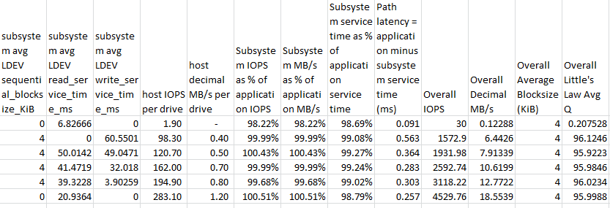
Subsystem data by rollup instance – csv columns
We know how many drives underlie the each workload rollup
Shows you if the OS / device driver are breaking up your large block application-level I/O into smaller pieces
Matching subsystem vs. application data validates that both host-workload rollups and subsystem data rollups are working correctly
Shows you if there is delay between when the application issues the I/O and when the device driver issues the I/O.
Shows you the amount of that delay in ms.

Slide 101
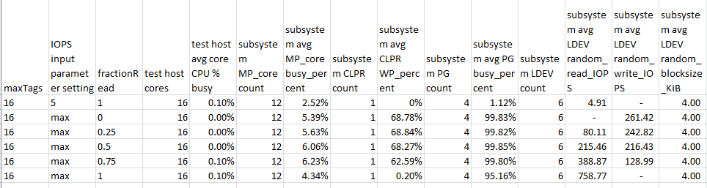
RMLIB API candidates flagged to display
The “subsystem” columns are automatically generated according to the focus metric RMLIB API candidate table.
As raw data comes in for each MP_core, CLPR, PG, LDEV, etc., ivy filters the data to aggregate for each rollup only the data for the MP_cores, etc. that map to LDEVs/LUNs underlying workloads in that rollup.
Make a rollup by MPU, and each MPU rollup instance will show data for 4 MP_cores.

Slide 102
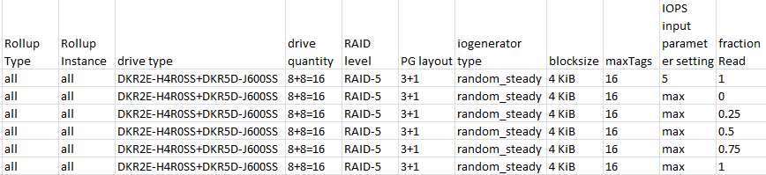
Examples of data for each rollup – drive / PG type
Information comes from RMLIB API configuration data, filtered / aggregated for each rollup instance.
(There are also dedicated csv folders that contain detailed RMLIB API subsystem configuration and performance data csv files.)

Slide 103
Now that we know how to specify the focus metric
We will look at
The [go] statement measure=on option and its subparameters
Specifying measure=on on a Go statement means "watch the focus metric and when you have seen enough to make a measurement of the specified accuracy, stop. Timeout if it takes too long."
The [go] statement dfc=pid option and its subparameters
If you don't specify a dfc, the workload settings remain constant through the test.
If you specify a dfc (dynamic feedback controller), it gets called at the end of every subinterval once all the rollups are done.
The DFC looks at what has happened so far, looking at all workload data and all subsystem data, and then may use the ivy engine real time edit rollup mechanism to send out parameter updates to rollup instances (to the workload threads belonging to the rollup instance).

Slide 104
measure = on
accuracy_plus_minus = 2%
Any numeric value with an optional trailing % sign maybe specified.
confidence = 95%
How confident you need to be that your measurement falls within the specified plus or minus range around the long term average that you would get measuring forever.
Default is 95%
Ivy has a menu of 11 specific pre-loaded confidence values that you pick from.
50%, 60%, 70%, 80%, 90%, 95%, 98%, 99%, 99.5%, 99.8%, and 99.9%
http://en.wikipedia.org/wiki/Student%27s_t-distribution

Slide 105
measure Write Pending-based stability criteria
max_wp = 2% - default 100%
A subinterval sequence will be rejected if WP is above the limit at any point in the sequence.
Set this to "1%' or so for read tests to ensure WP is empty during the test.
min_wp = 67% - default 0%
A subinterval sequence will be rejected if WP is below the limit at any point in the sequence.
Use this for write tests to ensure WP is full during the test.
max_wp_change = 3% - default 3%
A subinterval sequence will be rejected if WP varies up and down by more than the specified (absolute) amount at any point in the sequence. max_wp_range="3%" matches from 0% to 3% Write Pending, as well as from 67% to 70% Write Pending. (not a percent OF the WP value)
Use this in general all the time so you reject periods with major movement in Write Pending.

Slide 106
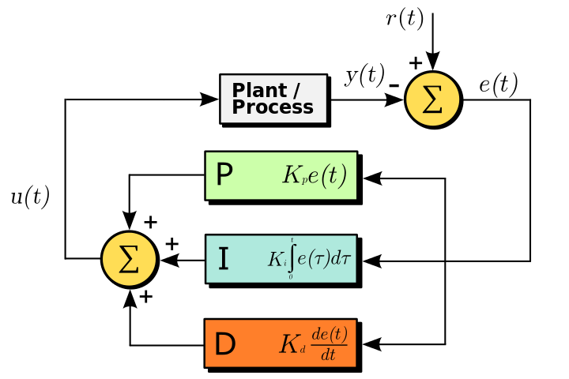
dfc=pid dynamically adjusts total IOPS
General purpose DFC – see http://en.wikipedia.org/wiki/PID_controller
The feedback is the value of the focus metric
source=workload
E.g. host-view service time, response time
source=RAID_subsystem
e.g. subsystem_element="PG", element_metric="busy_percent".
User specifies “p”, “i”, and “d” constants.

Slide 107
PID loop basics
See "PID loop" on wikipedia https://en.wikipedia.org/wiki/PID_controller
ivy's PID loop dynamically adjusts IOPS up and down to hit a target value for the focus metric.
The "error signal" is the difference between the measured focus metric value and the target value.

Slide 108
PID loop – computing new IOPS setting
The user provides 3 multiplier factor constants: p, i, d.
The new total_IOPS setting is
"p" times the error signal (proportional factor) + "i" times the sum of the error signal since the start of the test (integral factor) + "d" time the rate of change of the error signal (derivative factor)
The ivy engine "edit rollup" mechanism sends out the new total_IOPS setting to the focus metric's rollup instance (usually "all=all"), where it takes effect in real time.

Slide 109
[Go] parameter summary
Overall
stepname = stepNNNN
subintervalseconds = 5
warmup_count = 1
measure_count = 1
cooldown_by_wp = on
For dfc = pid
p = 0
i = 0
d = 0
target_value = 0
For measure = on
accuracy_plus_minus = 2%
confidence = 95%
50%, 60%, 70%, 80%, 90%, 95%, 98%, 99%, 99.5%, 99.8%, or 99.9%
max_wp = 100%
min_wp = 0%
max_wp_change = 3%
Focus metric
focus_rollup = all
source = ""
or workload / RAID_subsystem
subsystem_element = ""
element_metric = ""
category = overall
or read, write, random, sequential, random_read, random_write, sequential_read, sequential_write
accumulator_type = ""
or bytes_transferred, service_time, response_time
accessor = ""
avg, count, min, max, sum, variance, standardDeviation

Slide 110
<end> Thank You

